Slide 1
Enhancing Urban Canopy Features and Air Quality: WUDAPT Implementation Studies in Brazil
Maria de Fatima Andrade¹, Mario Gavidia Calderon¹, Edmilson Dias de Freitas¹, Taciana Toledo de Almeida Albuquerque^{2,3}
¹ University of São Paulo, ² Federal University of Minas Gerais, ³ Federal University of Espírito Santo - Brazil
22nd Annual CMAS Conference - 2023

Slide 2
Introduction
Urbanized areas have the potential to modify, locally or regionally, energy fluxes balance between the surface and the atmosphere by the land use changes.
To address the data gap in the urban landscape, the WUDAPT project focuses on creating a global database of cities suited for urban climate studies.
The Local Climate Zones (LCZ) classification system was created to partition the urban landscape cities into neighborhood types that can inform parameter selection in model applications.
2
Notes:
The multi-scale spatial characteristics of the urban boundary and canopy layers
Building Effect Parameterization (BEP)
building Energy Model
2

Slide 3
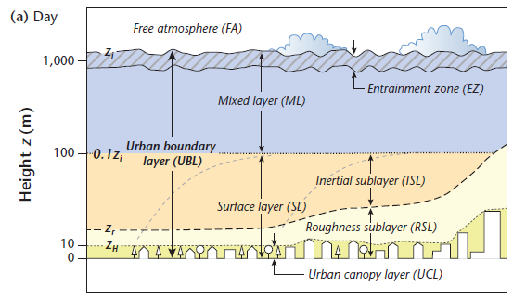
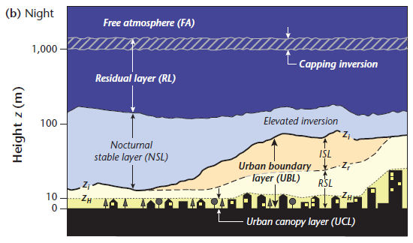
Introduction
There are 17 LCZ types, including different constructed and land cover types. To each LCZ is known data regarding surface properties, which can be used as input to urban canopy parameters (UCP).
Since WRF 4.3 version, the new version of the BEP+BEM scheme includes LCZ, Mitigation Strategies, Building Materials Permeability, and New Buildings Drag Coefficient.
The urban schemes are expected to estimate better airT, WS/WD, RH, precipitation, surface temperature, and other parameters.
3
Source: OKE et al., 2017
Notes:
3

Slide 4
Objective
Case studies in Brazil by WUDAPT/LCZ applications
Papers objectives:
Improve input dataset to apply in the WRF model
LCZ info to apply in Air Quality Models (WRF-Chem and Munich)
Urban Heat Island formation from the perspective of the LCZ
4
Notes:
4

Slide 5
Effect of Local Climate Zone (LCZ) Classification on Ozone Chemical Transport Model Simulation in São Paulo, Brazil
Authors: Dirce Maria Pellegatti Franco, Maria de Fátima Andrade, Rita Yuri Ynoue, Jason Ching
Highlights:
•Impact of different urban land cover on air quality simulations.
•Better representation of surface wind with BEP-WUDAPT.
Urban Climate, Vol 27, March 2019, Pages 293-313
https://doi.org/10.1016/j.uclim.2018.12.007
Notes:
Two different urban surfaces parameterizations were taken into account in the simulations for the finer domains: off (default) and multi-layer Building Environment Parameterization (BEP) (Martilli et al., 2002). In the finer grid (1 km resolution), the simulation with BEP considered 10 urban surface cover types of the Local Climate Zone (LCZ) classification (Stewart and Oke, 2012)

Slide 6
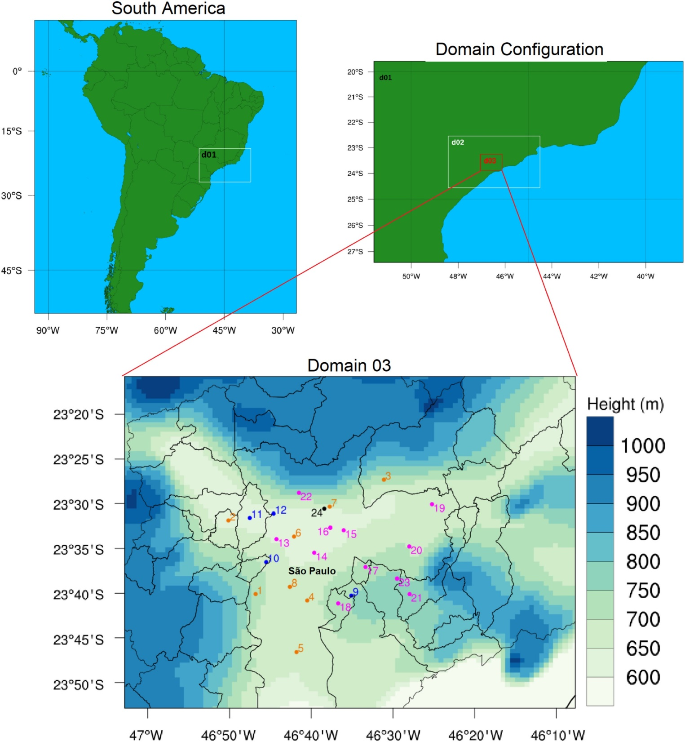
Modeling Domains
WRF-Chem Version 3.7.1
Network Air Quality and Meteorological Stations
8 meteorology and ozone stations (orange)
3 meteorology stations (blue)
10 ozone stations (magenta)
ozone-sounding (black)- experimental campaign from 01 to 03 Nov 2013
Urban Climate, Vol 27, March 2019, Pages 293-313
https://doi.org/10.1016/j.uclim.2018.12.007
Notes:
The data used for the model evaluation included hourly observations from eight surface temperature, seven relative humidity, ten wind speed and direction and 19 ozone stations (Fig. 1). In addition, we used five meteorological and ozone soundings launched from the airport base of Campo de Marte at latitude 23°31′36” S and longitude 46°38′24” W.

Slide 7
Modeling Physical Parametrizations
off (default) and multi-layer Building Environment Parameterization (BEP)
Urban Climate, Vol 27, March 2019, Pages 293-313
https://doi.org/10.1016/j.uclim.2018.12.007

Slide 8
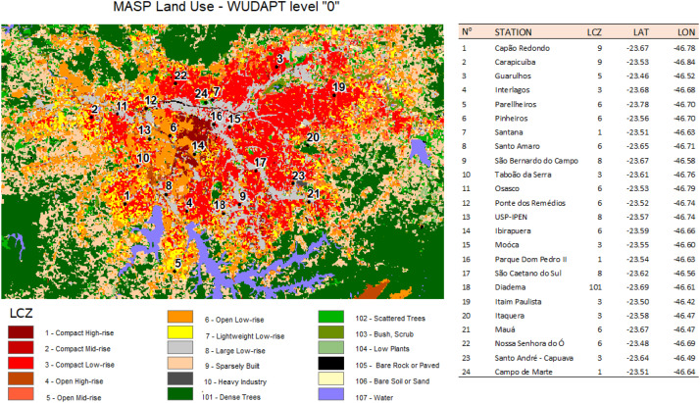
Local Climate Zone WUDAPT level “0” classification
Urban Climate, Vol 27, March 2019, Pages 293-313
https://doi.org/10.1016/j.uclim.2018.12.007

Slide 9
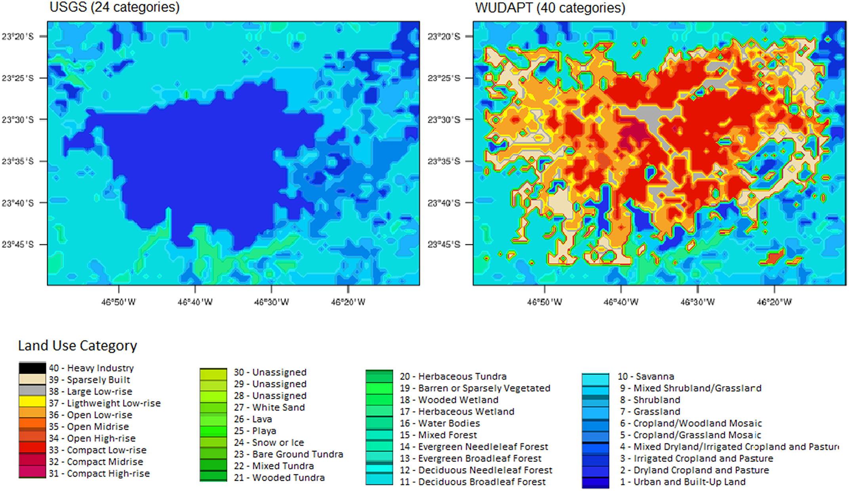
Land use configuration used in the simulations for USGS (left), WUDAPT (right)
Urban Climate, Vol 27, March 2019, Pages 293-313
https://doi.org/10.1016/j.uclim.2018.12.007

Slide 10
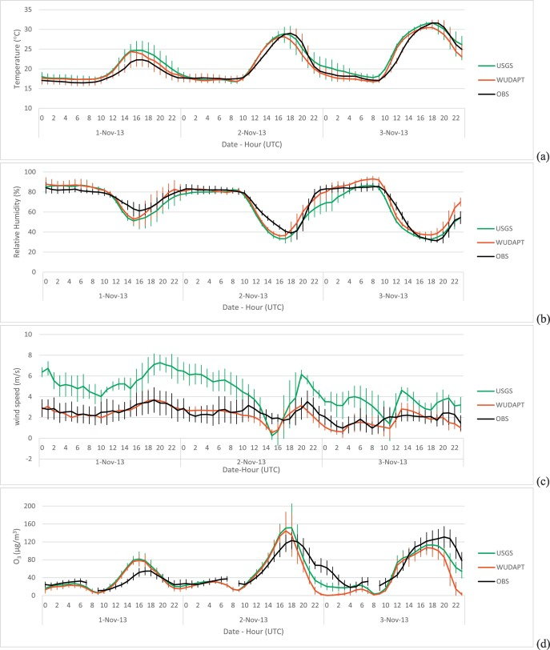
2-m temperature
Results
Comparison of averaged observations (black) in the MASP and averaged simulations, USGS (green) and BEP-WUDAPT (red)
(b) relative humidity
(c)10-m wind speed
(d) ground level ozone
Urban Climate, Vol 27, March 2019, Pages 293-313
https://doi.org/10.1016/j.uclim.2018.12.007

Slide 11
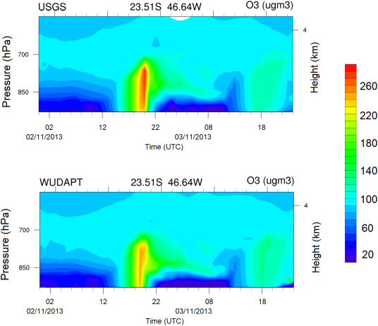
The main reason for the BEP-WUDAPT simulated O₃ lower than the USGS at peak times may be the shadowing and radiative trapping effects in street canyons from the BEP parameterization.
Vertical ozone diurnal variation over Campo de Marte for (a) USGS, and (b) BEP-WUDAPT.
https://doi.org/10.5194/gmd-14-3251-2021

Slide 12
Simulation of O₃ and NOx in São Paulo Street Urban Canyons with VEIN (v0.2.2) and MUNICH (v1.0)
Authors: Gavidia-Calderón, M. E., Ibarra-Espinosa, S., Kim, Y., Zhang, Y., and Andrade, M. D. F
Geosci. Model Dev., 14, 3251–3268, 2021
https://doi.org/10.5194/gmd-14-3251-2021

Slide 13
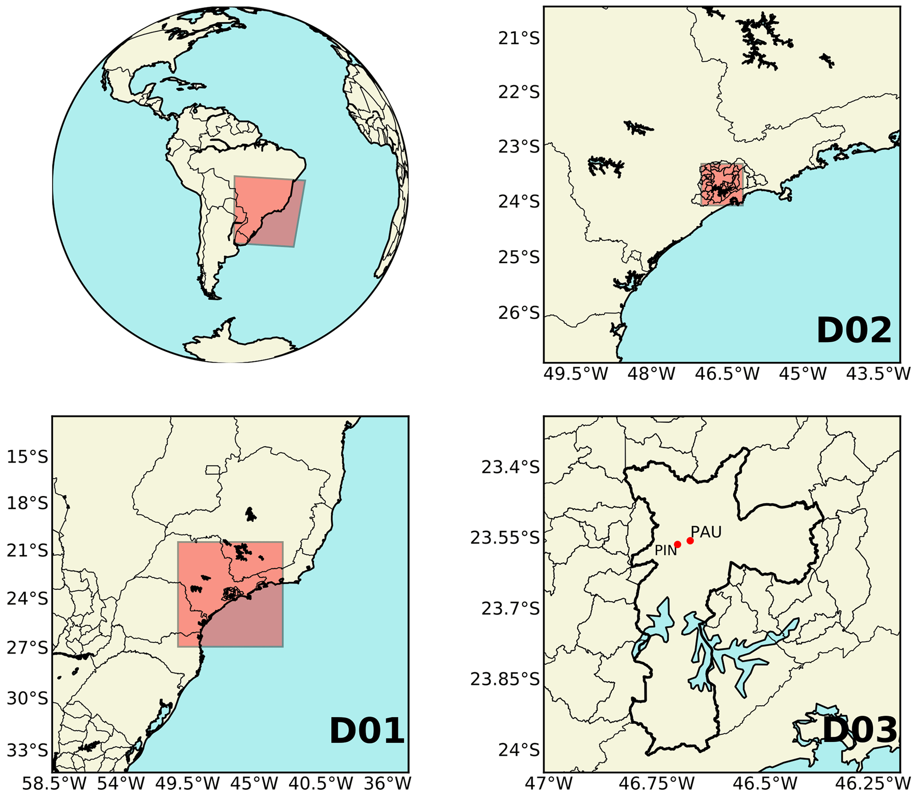
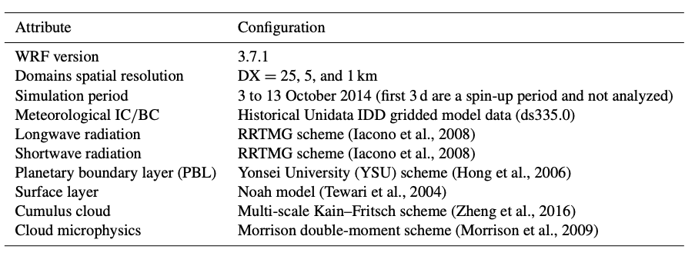
Methodology: WRF Domains
WRF simulation domains of 25 km (D01), 5 km (D02), and 1 km (D03) spatial resolution.
D03 provides the meteorological information for MUNICH, the city of São Paulo is outlined in a thick black line, and the red dots show MUNICH domain locations.
https://doi.org/10.5194/gmd-14-3251-2021
Gavidia-Calderon et al., GMD, 14,2021

Slide 14
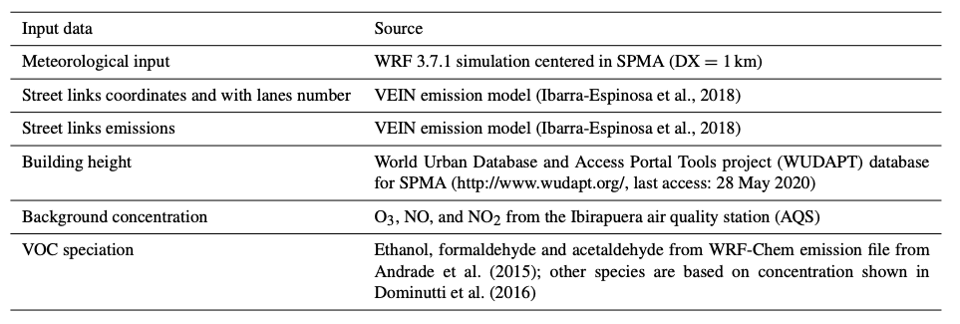
MUNICH input data
Model of Urban Network of Intersecting Canyons and Highways
https://doi.org/10.5194/gmd-14-3251-2021
Gavidia-Calderon et al., GMD, 14,2021
Notes:
Because VEIN model used OpenStreetMap database, it includes number of street lanes. We calculate street width by using and average lane width of 3 m and sidewalk width of 1.9 m (which is a value recommended by Sao Paulo Municipality). So:
Street width = 2 * sidewalk width + 3 * street lanes

Slide 15
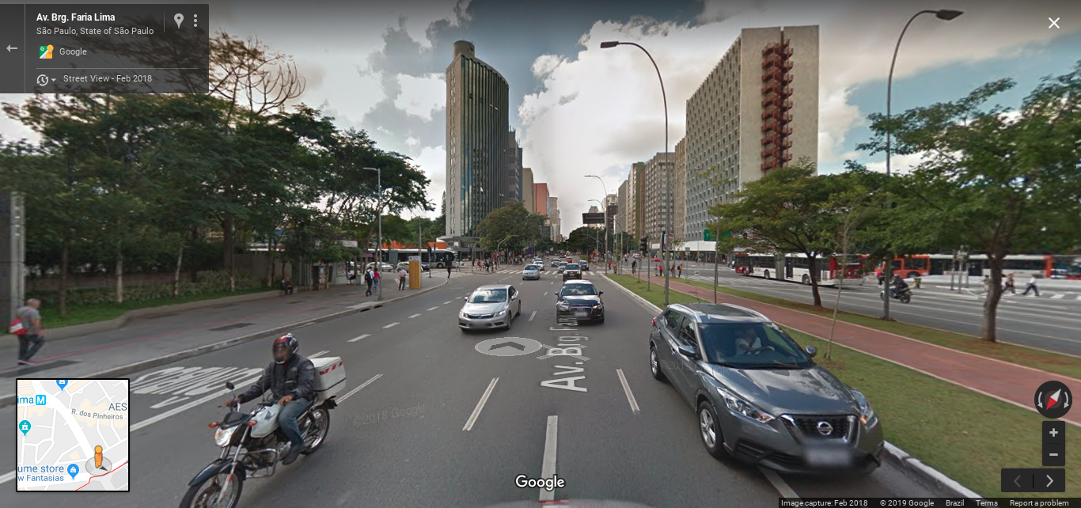
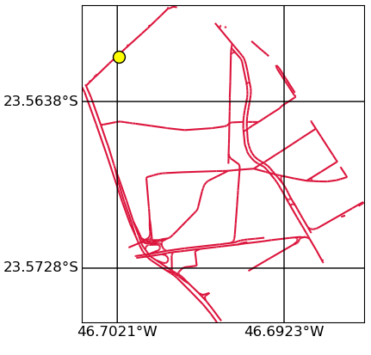
MUNICH Domains - Pinheiros
30 % LCZ1 (Compact high rise)
30 % LCZ8 (Large Low Rise Building height between 5 -10m)
40% LCZ6 (LCZ 6 – open low rise Building height of 5 m )
9 grid points from WRF cover the Pinheiros area

Slide 16
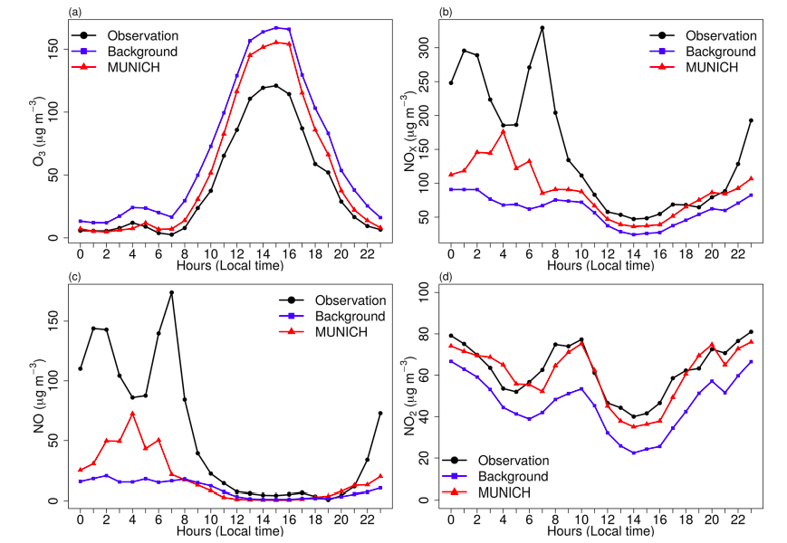
MUNICH RESULTS
Diurnal profile of MUNICH results, background, and concentrations of (a) O3, (b) NOx , (c) NO, and (d) NO2 for the Pinheiros urban canyon from the control case
Notes:
Figure 6 shows the results of MUNICH simulation using the original emissions calculated by VEIN for SPMA. MUNICH simulations are very close to background concentrations, which leads to an overprediction of O3 and underpredicted NO and NOx concentrations. This is produced by a dependence of MUNICH on background concentration and by emission underestimation. The emission underestimation is caused by emission factors calculated based on average measurements of emissions certification tests and because emission factors derived from a dynamometer, and cycle measurements do not represent real-drive emissions (Ropkins et al., 2009). It is also probable that the number of vehicles could have been underestimated inside the urban canyon. The underestimation of NOx is caused by the underestimation of NO concentrations. NO2 concentration magnitude is well represented by MUNICH.

Slide 17
Improving The WRF Model Performance By Using The Local Climate Zones Approach Integrated With Mapbiomass Land Surface Data For São Paulo, Brazil
Work in progress (Poster Presentation 22nd CMAS Conference 2023)
Authors: Taciana Alburquerque, Rizzieri Pedruzzi, Yasmin Kitagawa, Otavio Sobrinho, Leonardo Hoinaski, Davidson Martins, Mario Calderón, Edmilson Freitas and Maria de Fátima Andrade
The main objective was to evaluate the effects of the update of LULC with the LCZ in WRF V4.4.2 results.
Scenarios were performed:
Scenarios:
upWRF (MAPBIOMASS)
upWRF BEP
upWRF LCZ BEP
upWRF LCZ BEP+BEM
17
Notes:
We expect to verify the simulated temperature and humidity improvement, especially by using BEP and the LZC.
17

Slide 18
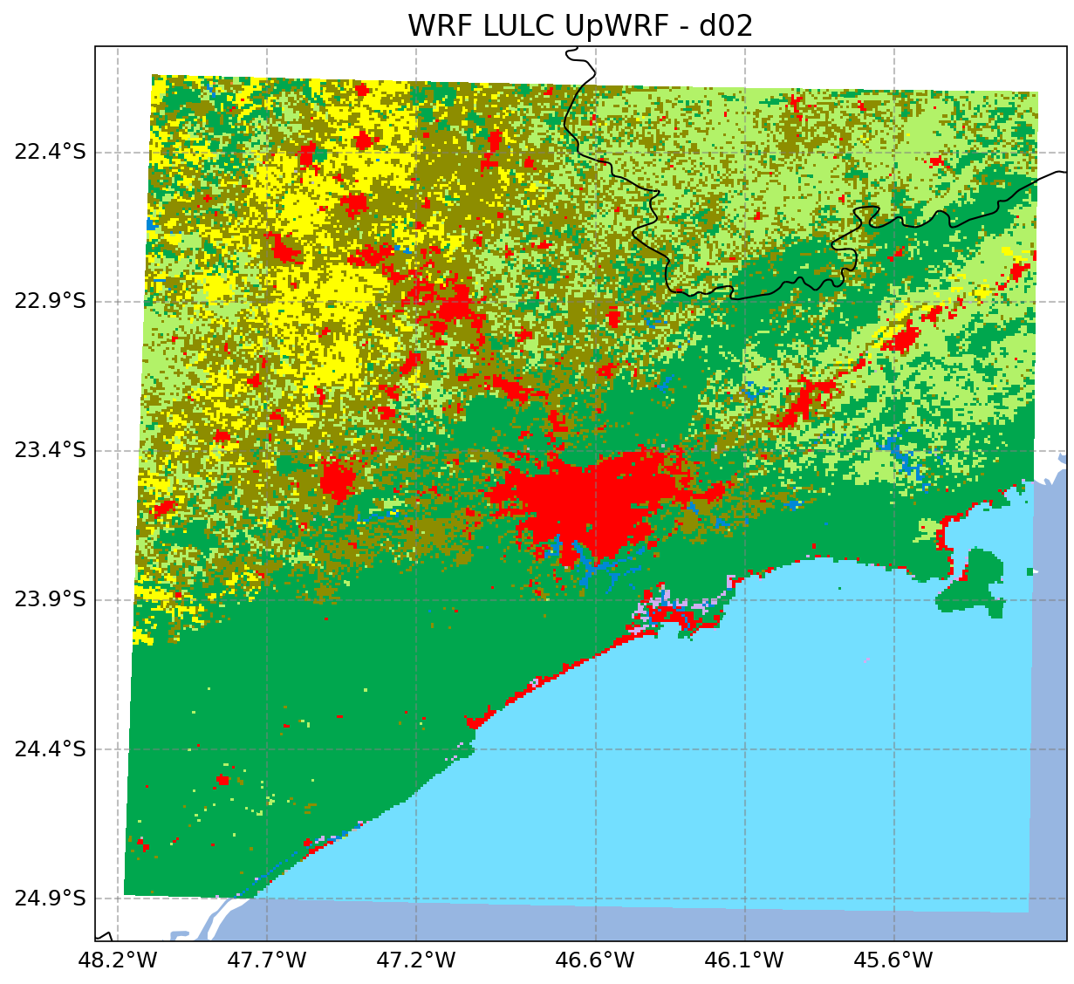
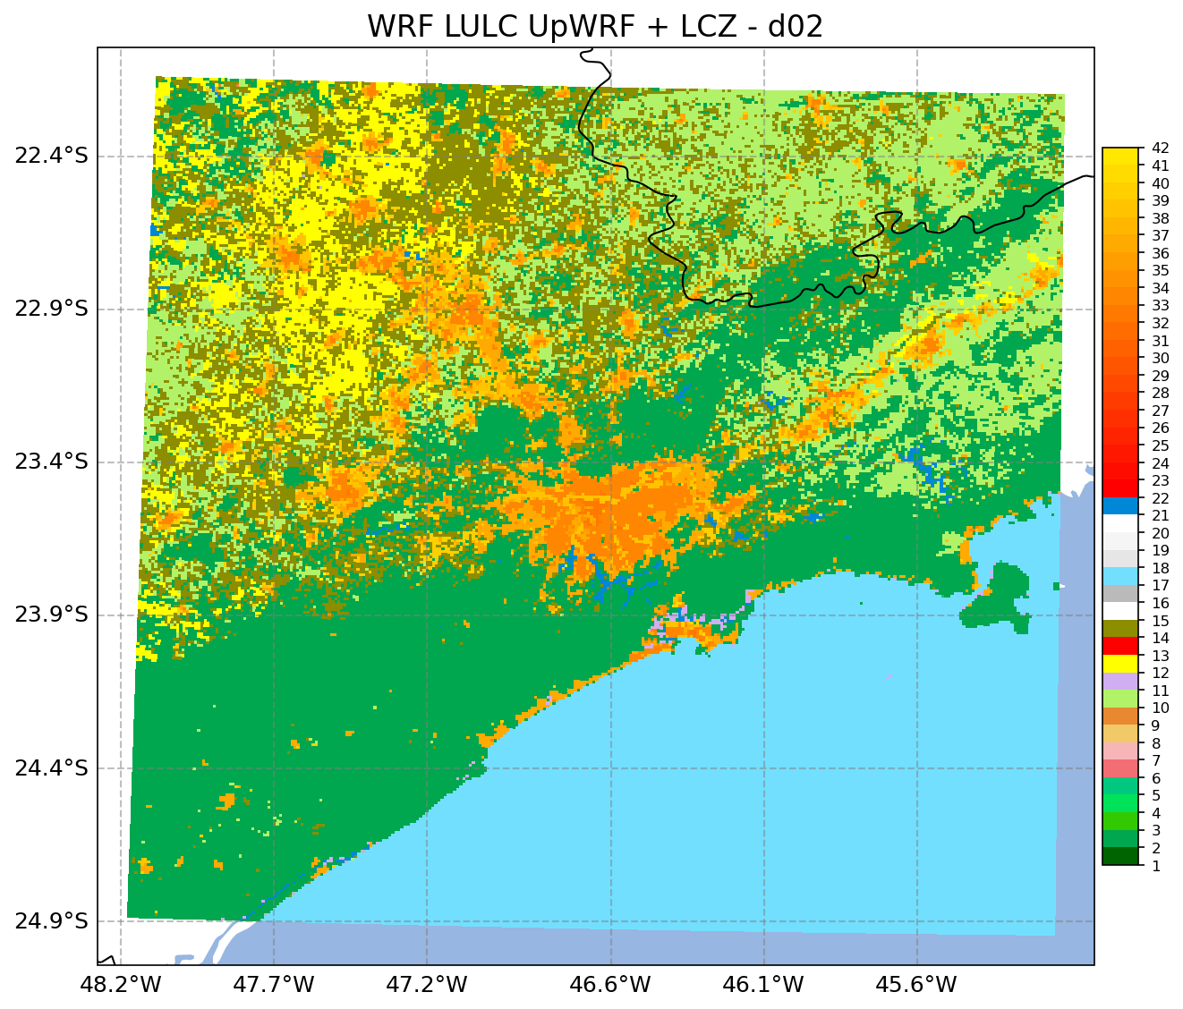
Results
Reclass urban areas to Wudapt classification using w2w https://www.wudapt.org/wudapt-to-wrf/
Update LULC according to Pedruzzi et al. (2022) using MapBiomas https://brasil.mapbiomas.org/en
WPS processing
WRF model
Stewart et al., 2014
Notes:
Building height was retrieve from WUDAPT information for SPMA. WUDAPT divides SPMA in 17 Local Climatic Zones (LCZs). These LCZs are divided in two groups: Building types (1-10) and Land Cover types, from (A-G). These LCZs have different geometric, thermnal, radiative and surface cover properties. We use Building Height. This file has a Dx = 120 m, so we retrieve the building height of each street link.
Quanto maior a fração urbana, menor é o fluxo de calor latente produzido, como esperado. Em uma LCZ 1, somente 10% é fração vegetada, enquanto em uma LCZ 9 é de 60%.
30 % LCZ1 (Compact high rise) 30 % LCZ8 (Large Low Rise Building height between 5 -10m)

Slide 19
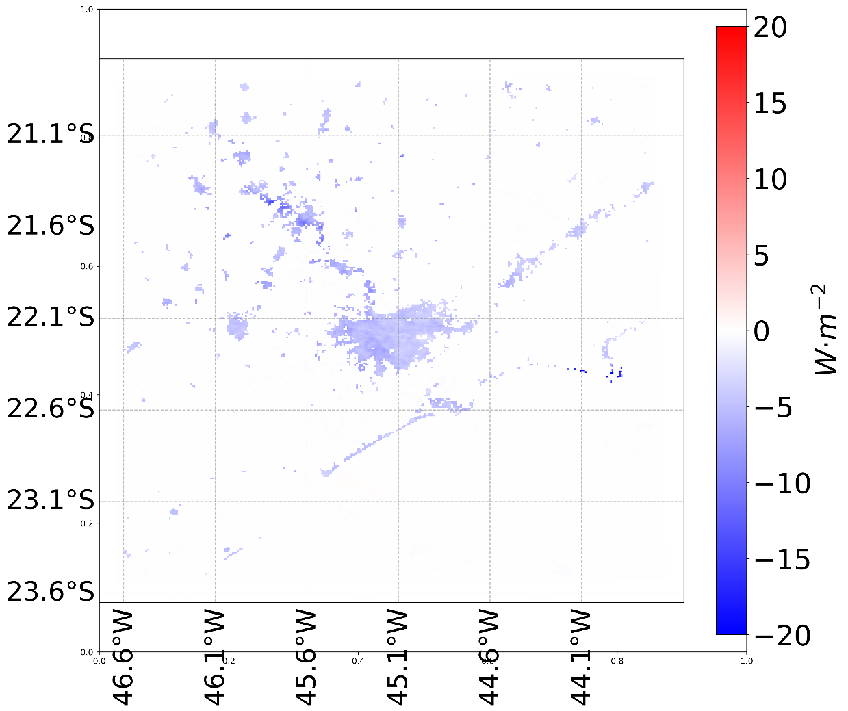
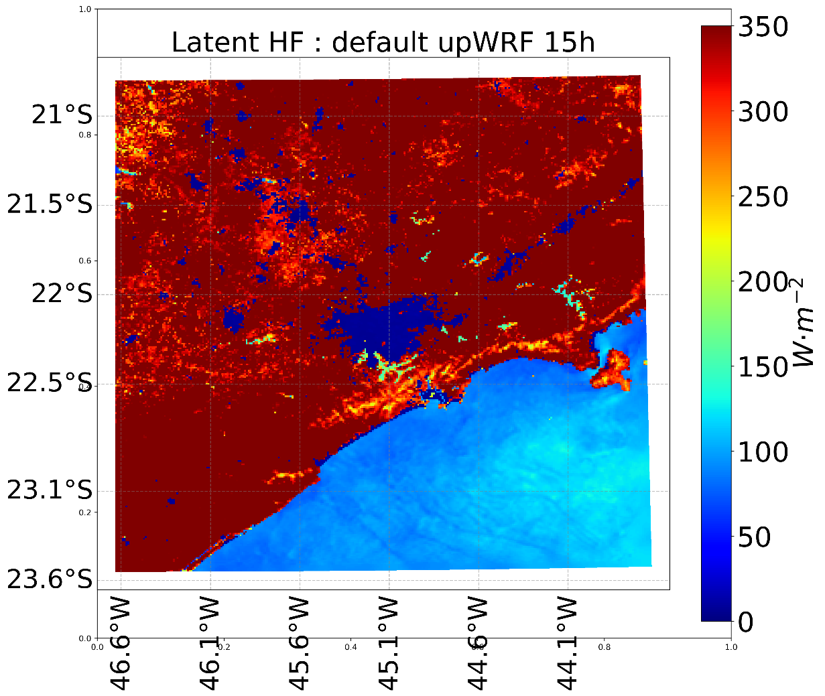
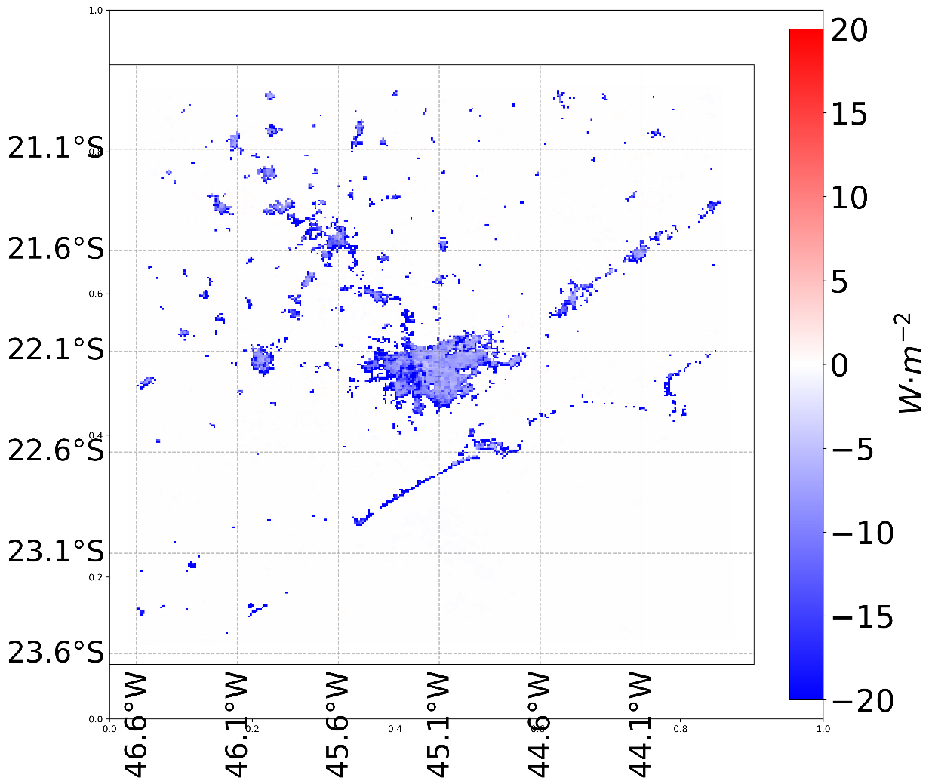
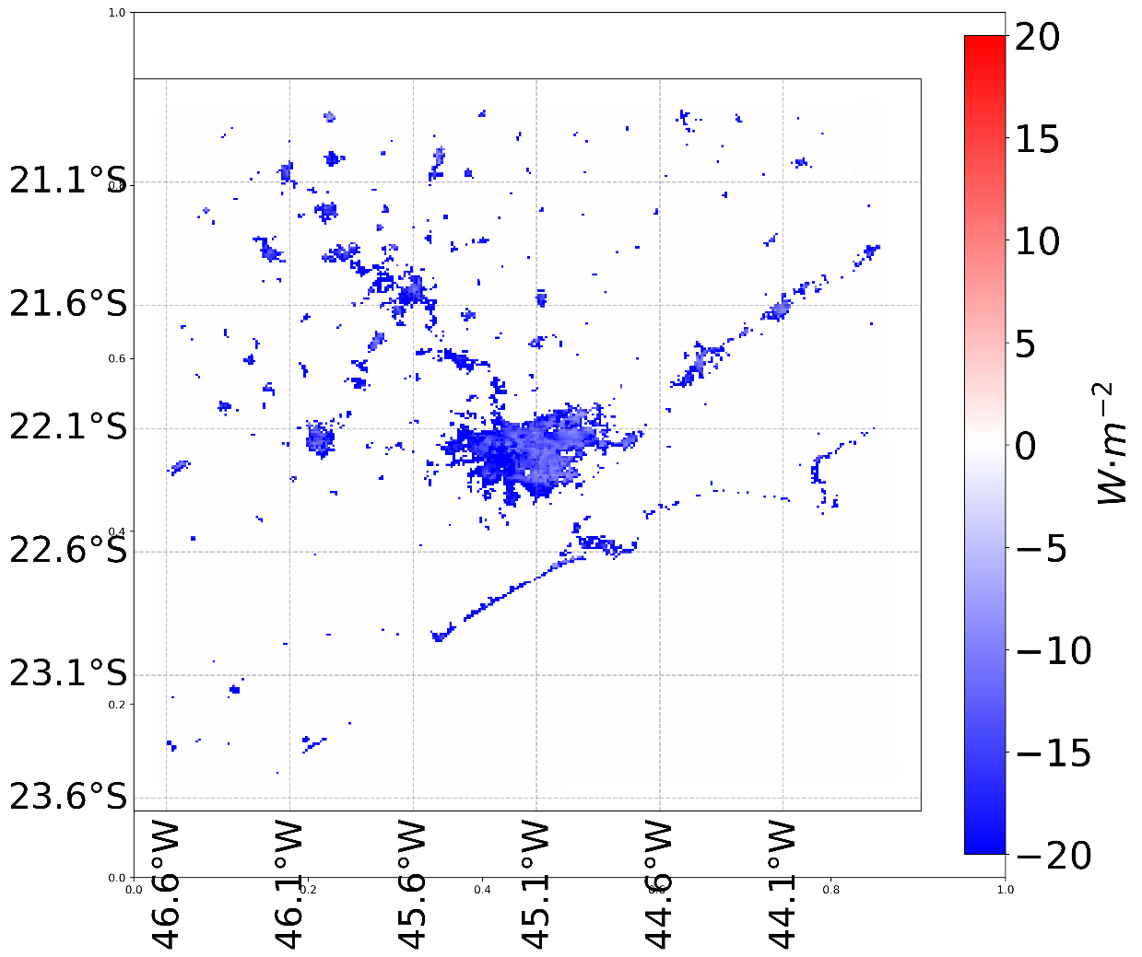
Results
2. upWRF - upWRF BEP
3. upWRF - upWRF LCZ BEP
1. upWRF
4. upWRF - upWRF LCZ BEP+BEM
Increasing the latent heat flux by decreasing the urban fraction

Slide 20
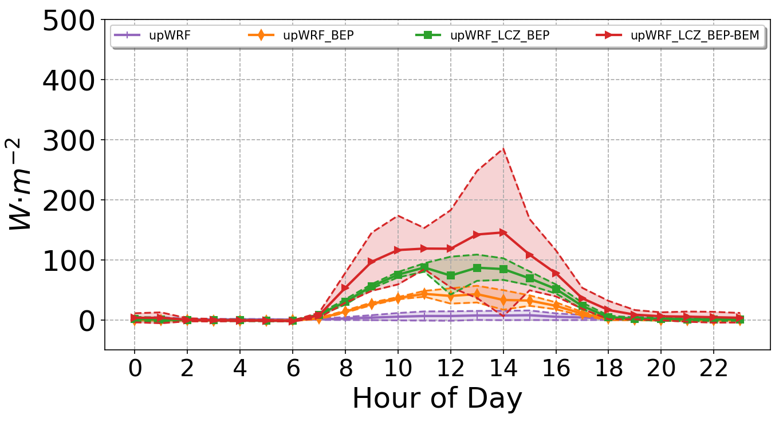
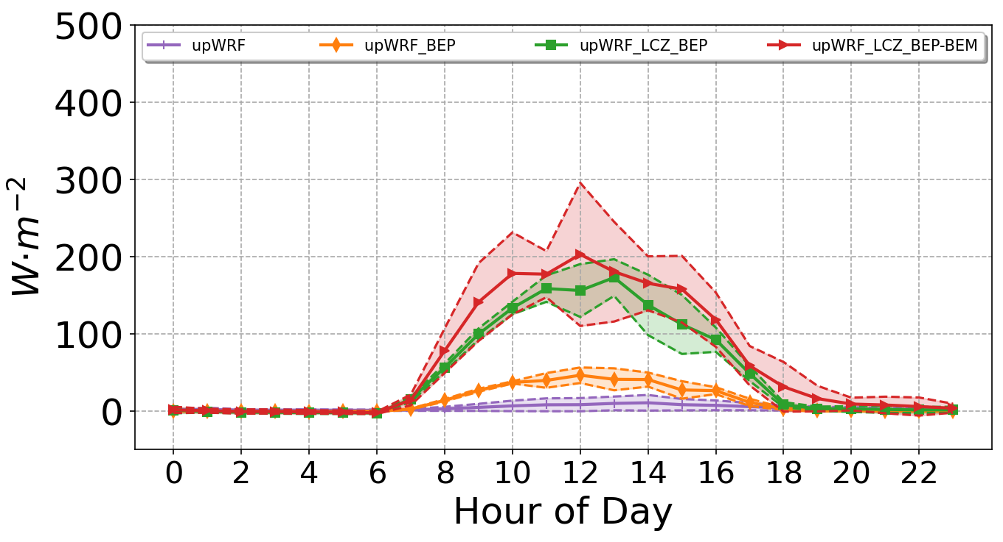
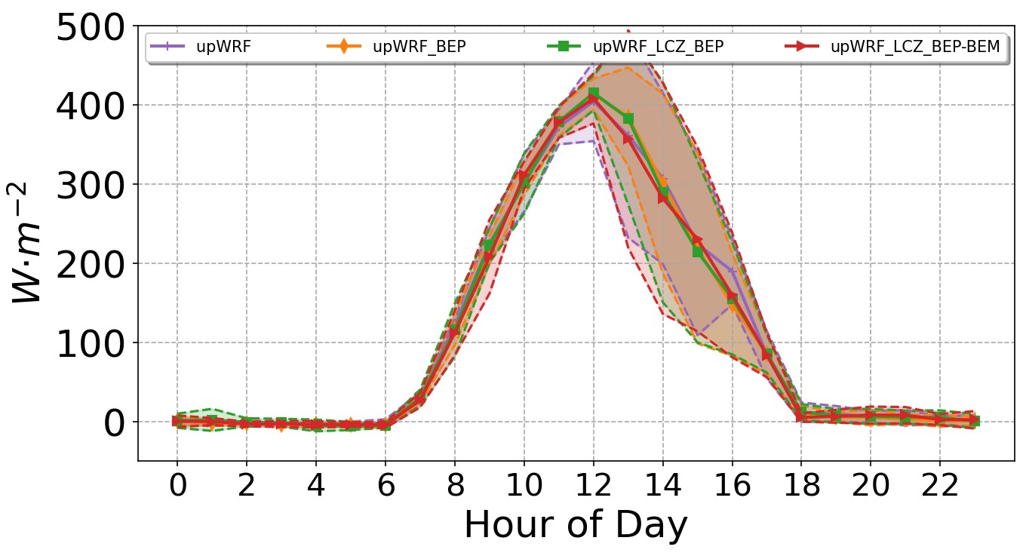
Results
LATENT HEAT FLUX
Interlagos
LU Urban and Built
Ibirapuera
LU Urban and Built
São Luiz do Paraitinga
LU Grassland
The different daily profiles from different monitoring stations show the influence of LCZ / BEP+ BEM in latent heat flux
By changing the latent heat flux, the Superficial Layer and Land Surface Model parameterizations will be affected

Slide 21
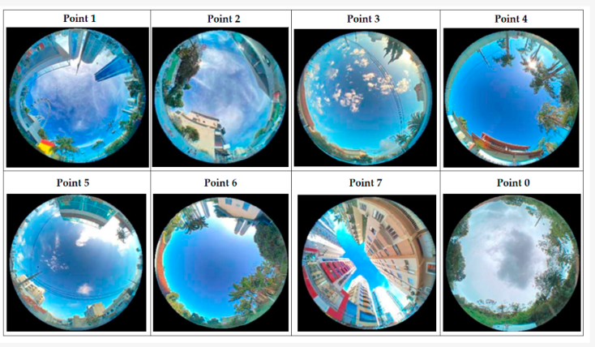
Local Climate Zones, Sky View Factor and Magnitude Daytime/Nighttime Urban Heat Island in Balneário Camburiú, SC, Brazil
Authors: Ismael Hoppe, Cassio Wollmann, André Buss, João Gobo, Salman Shooshtarian
Sky View Factor of the urban climate data collection points in Balneário Camboriú.
They applied the definitions of urban and rural landscapes through the LCZ:
- City construction
(building materials and verticalization)
- Land Cover type
Hoppe et al. (2022): Climate 2022, 10(12), 197; https://doi.org/10.3390/cli10120197
Notes:
21

Slide 22
Finds
Formation of Urban Heat Islands whose maximum magnitude was 10.8 °C and islands with freshness of magnitudes of −4.5 °C.
22
Hoppe et al. (2022): Climate 2022, 10(12), 197; https://doi.org/10.3390/cli10120197
Notes:
- There was a significant variation of the Sky View Factor between the collection points, and different LCZs were mapped.
22

Slide 23
Remarks
WUDAPT database provides valuable insights into the representation of urban processes in meteorological models.
The WRF model, when coupled with urban canopy schemes such as the multi-layer Building Environment Parameterization (BEP) and Building Energy Model (BEP + BEM), can simulate the urban atmospheric processes more realistically.
The difficult is urban modules require, as input data, each class, radiative and thermal properties, besides morphological parameters (building height distribution and street orientation).
Notes:
23

Slide 24
Special Thanks!
https://ral.ucar.edu/sites/default/files/docs/chen-wrf-urban-wudapt-jan2022.pdf

Slide 25
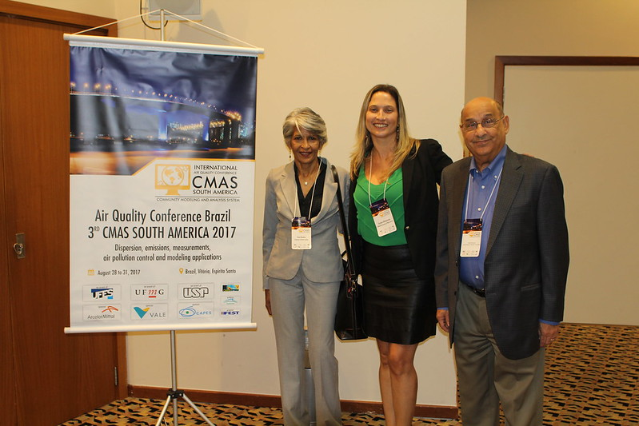
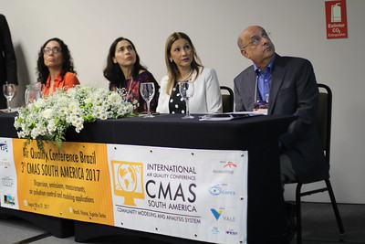
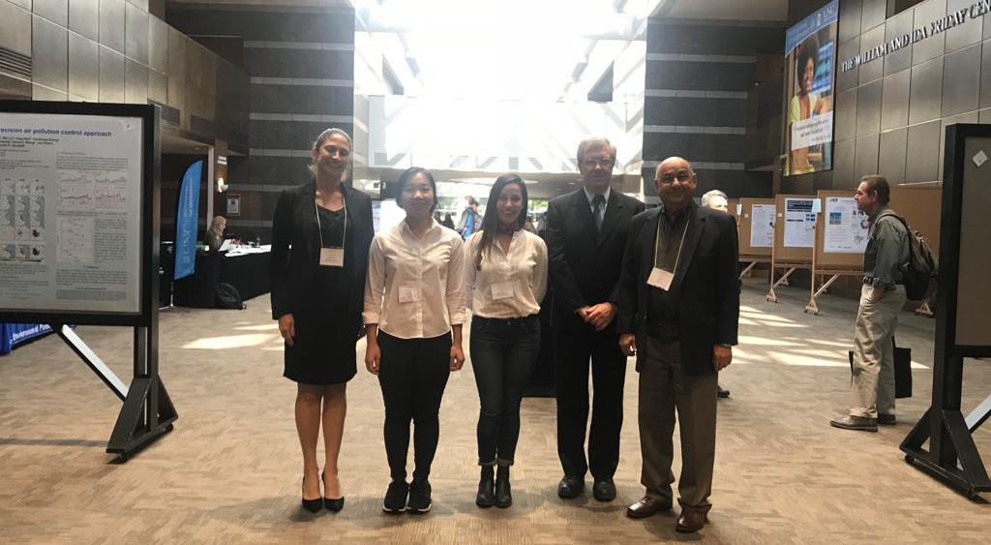
Memories with Adel Hanna
Vitória, Espirito Santo State – Brazil - CMAS South America 2017
CMAS Asia & ABACAS – May 2018, Pequim - China
CMAS 2018 – Student poster winner

Slide 26
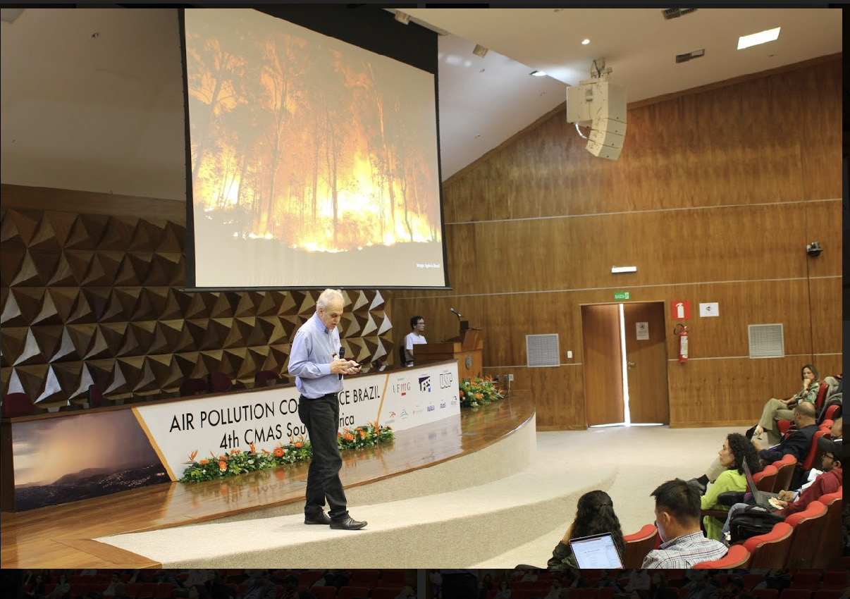
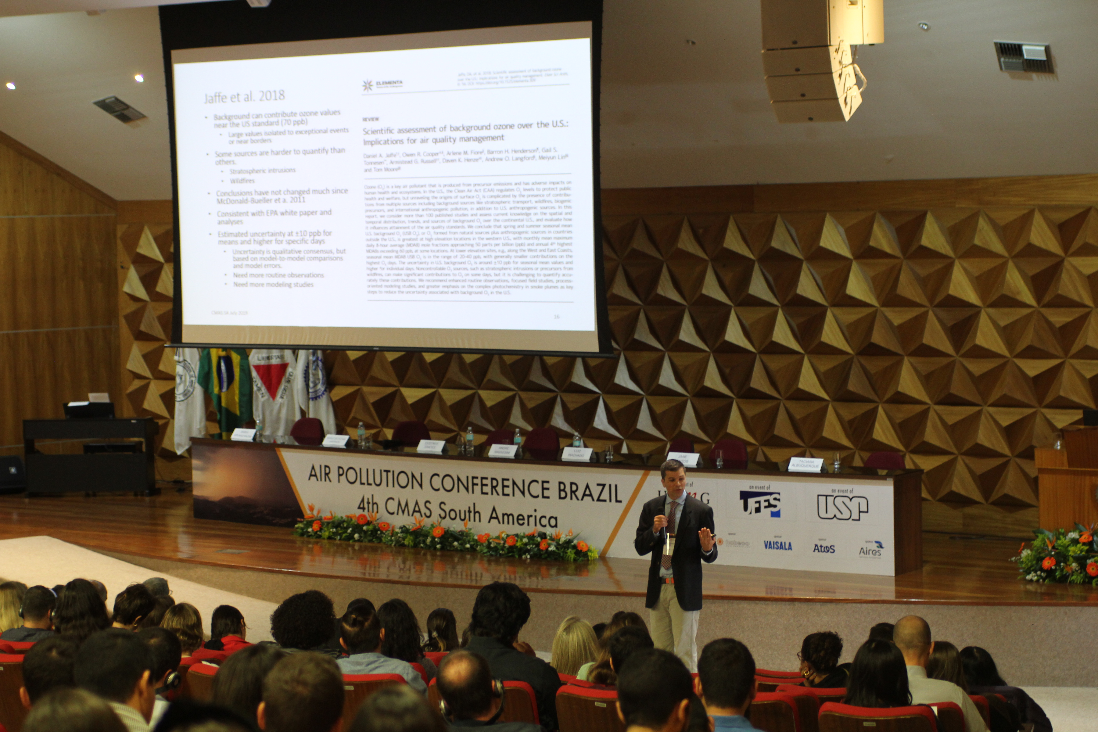
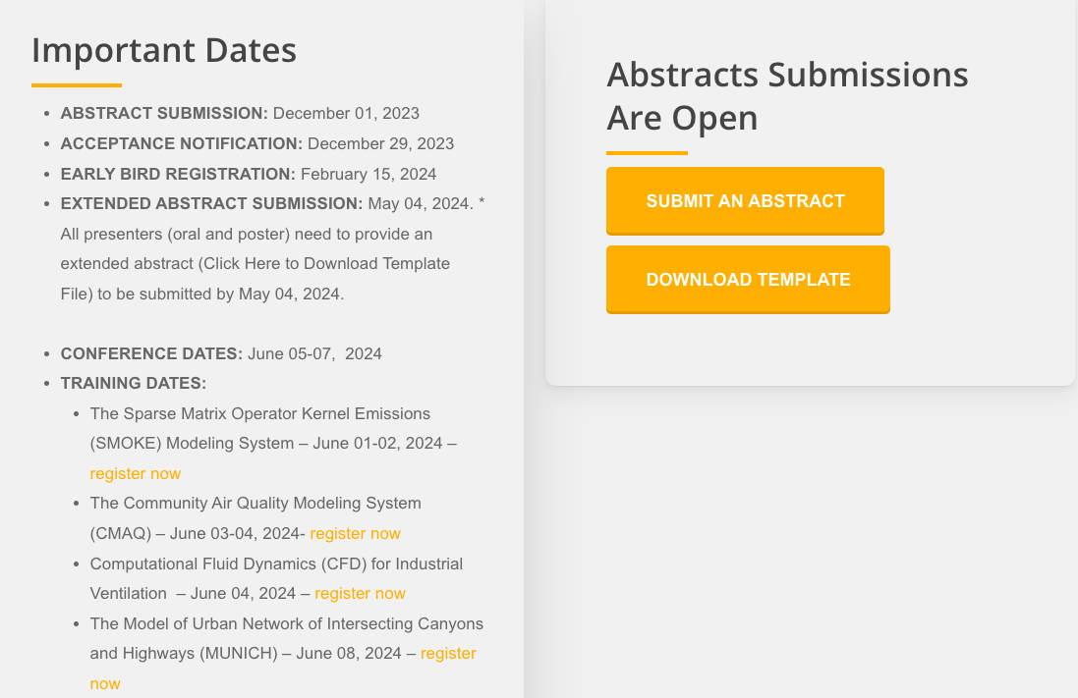
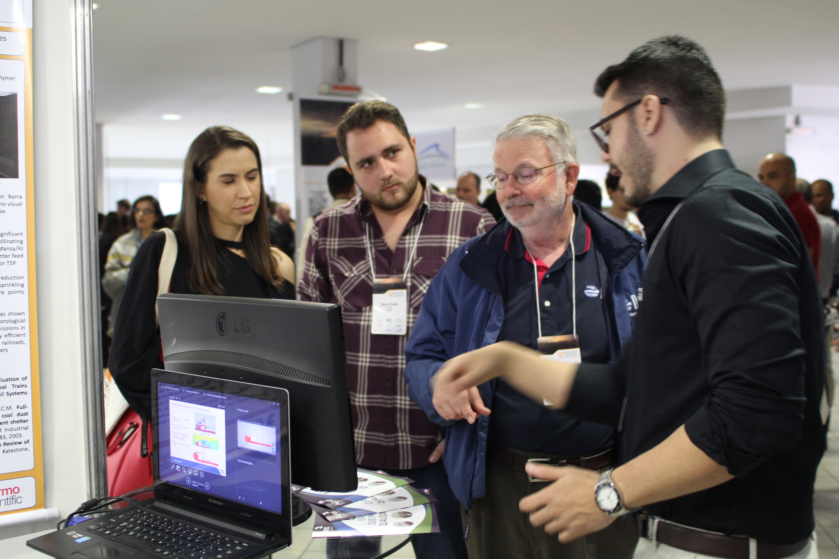
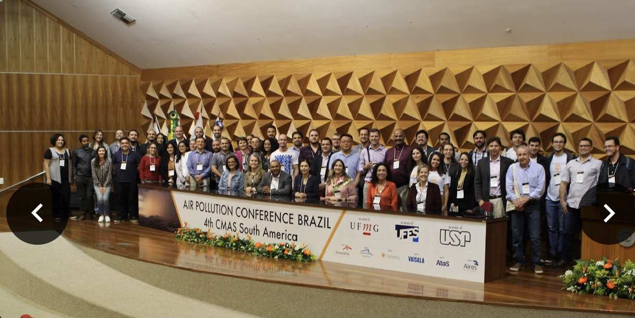
CMAS SA 2019

